Slide 1
Managing Subscriptions and RBAC
Create a New Resource Group “RG1”
Create a Management Group “az104-mg1-test1”
Create a Custom Role for Microsoft support requests.
Assign Role to Helpdesk Group which has hd1 user as a member
Log In as User hd1 and Test the Permissions
Test Microsoft Support Access: Success
Note:- you can assigning roles at different levels (management group, subscription, or resource group), you can implement RBAC to ensure proper governance

Slide 2
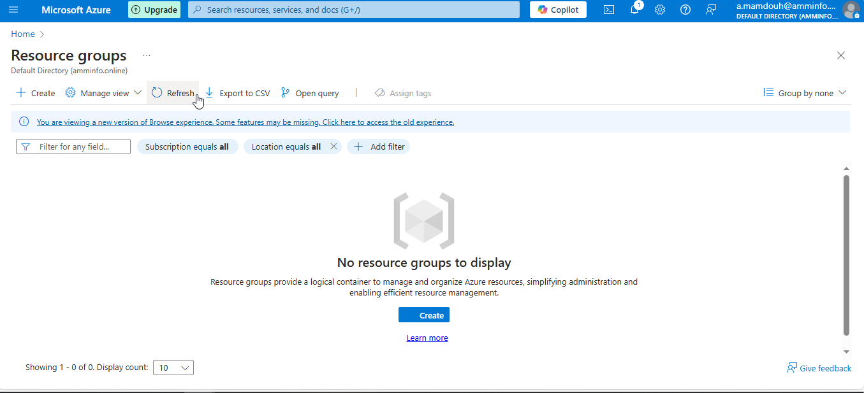
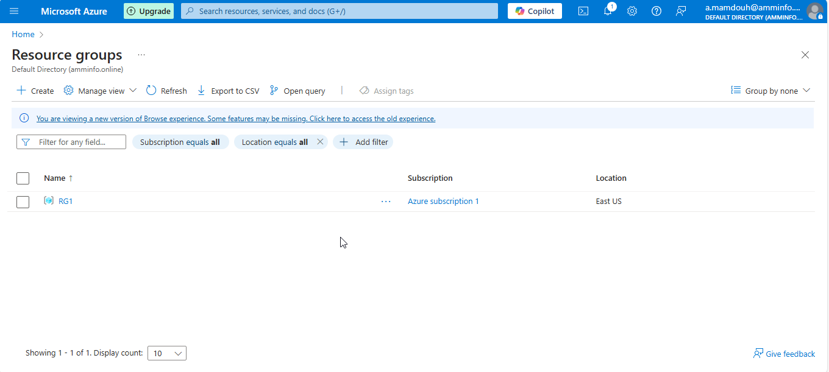
Notes:
Create a resource group

Slide 3
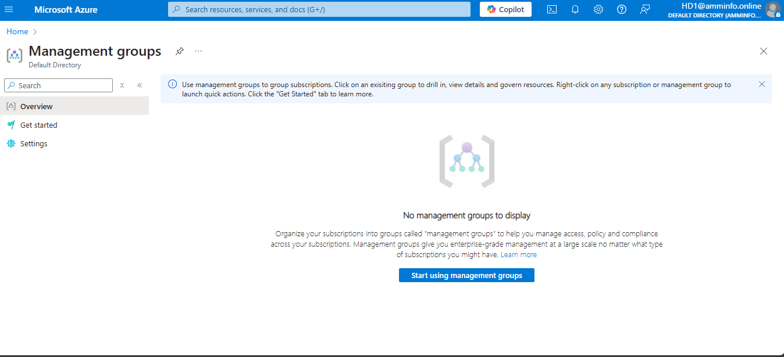
Notes:
Create az104-mg1-test1 management group

Slide 4
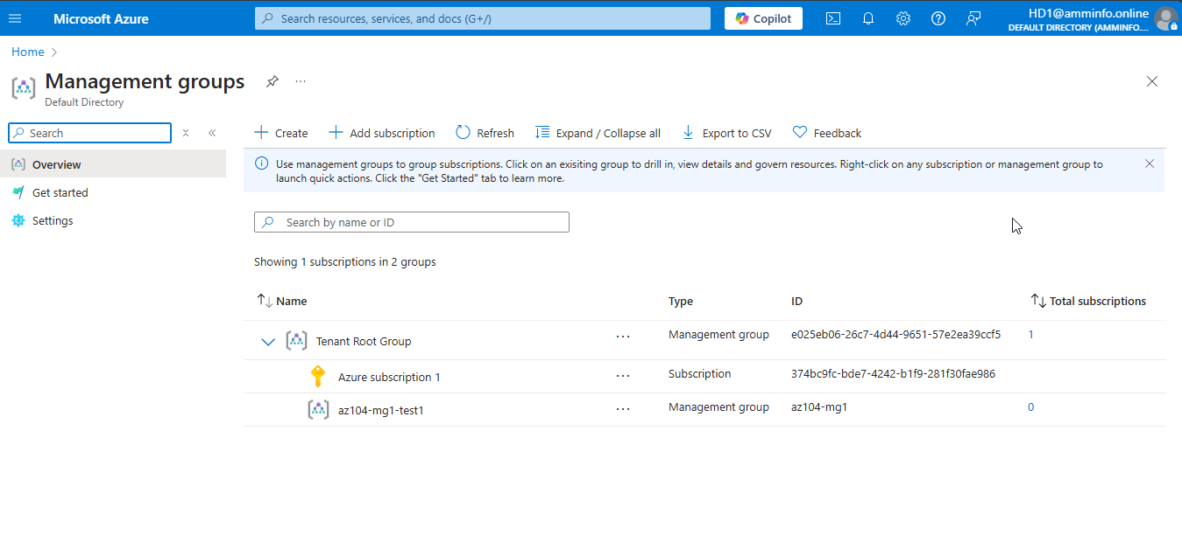

Slide 5
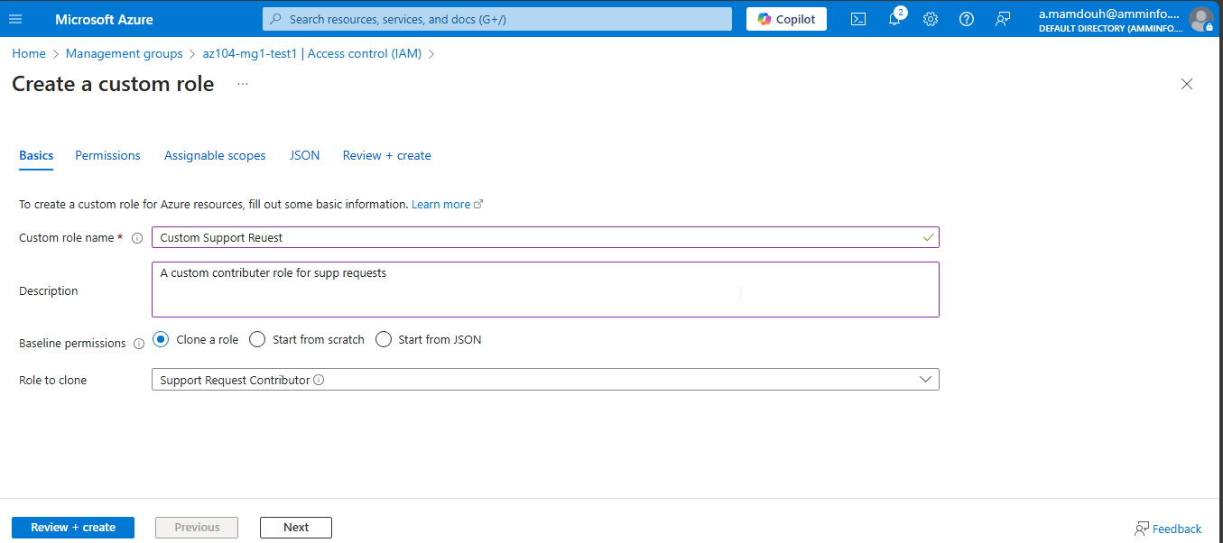
Notes:
Create a custom RBAC role

Slide 6
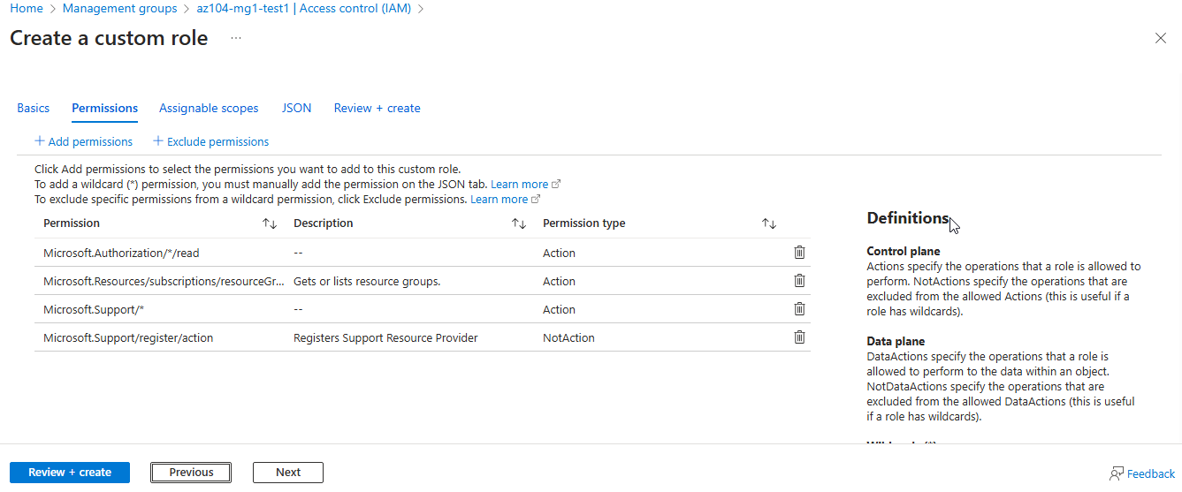
Notes:
select Microsoft support permission and Assigning it to help desk user in next step “assignable scope”

Slide 7
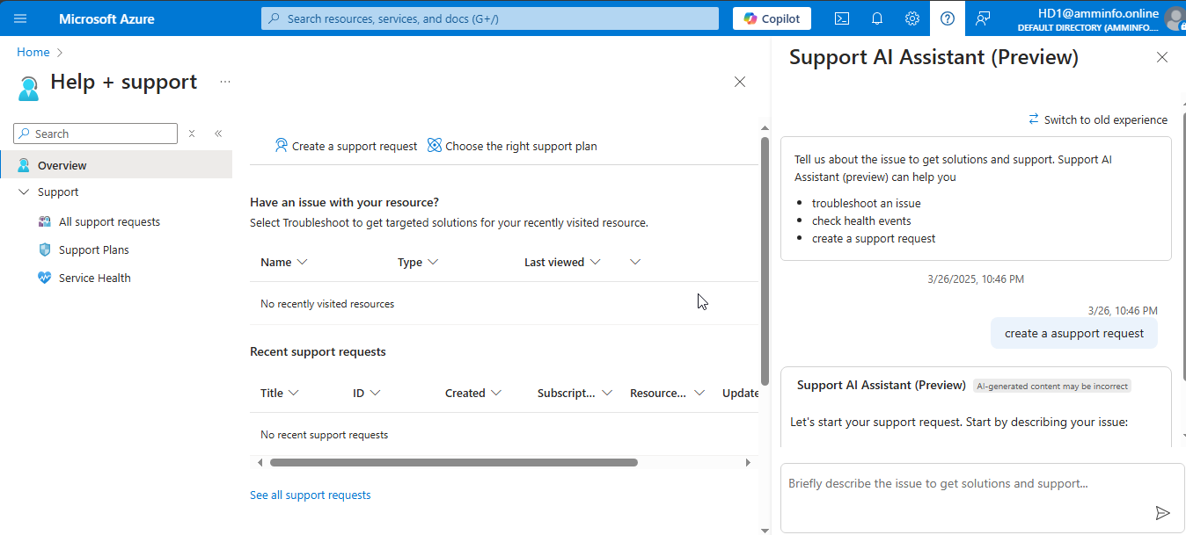
Notes:
Login using help desk account and try to create support request

Slide 8
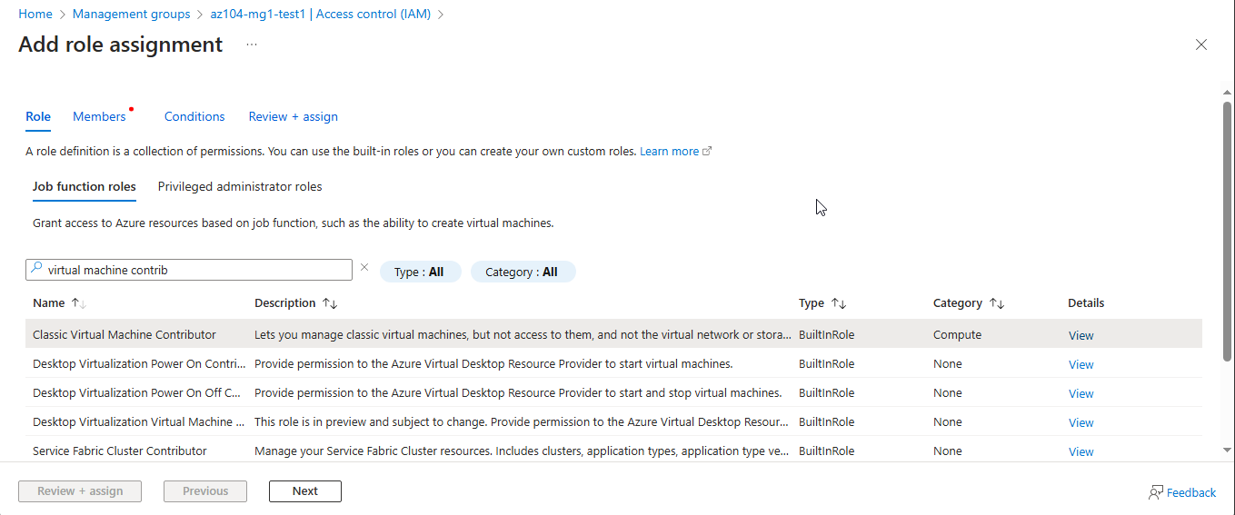
Notes:
on az104-mgmt. group select IAM to control access on this mgmt. group level and choose vm contributer

Slide 9
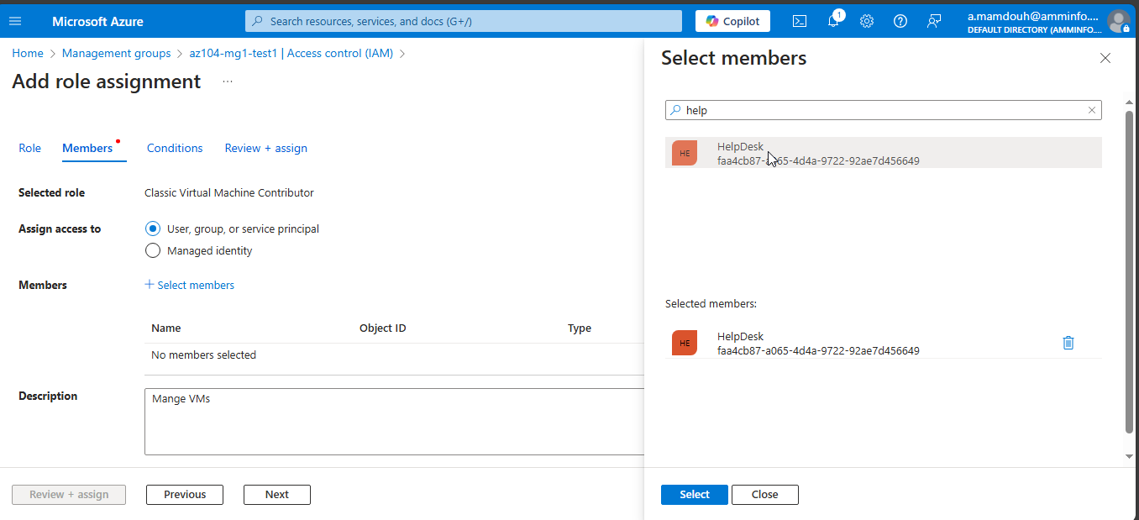
Notes:
Add helpdesk group which has hd1 user as a member

Slide 10
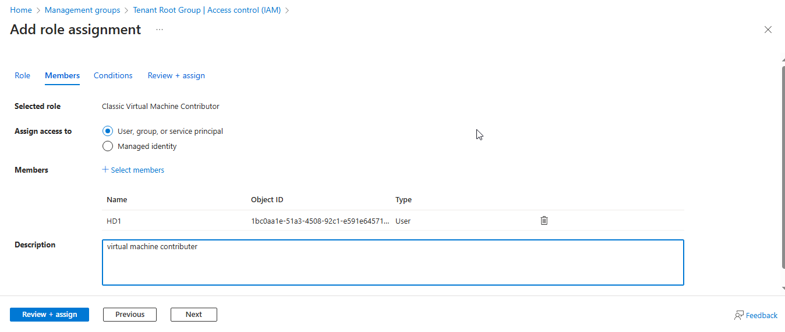
Notes:
Vm contributer role = full permissions to manage virtual machines

Slide 11
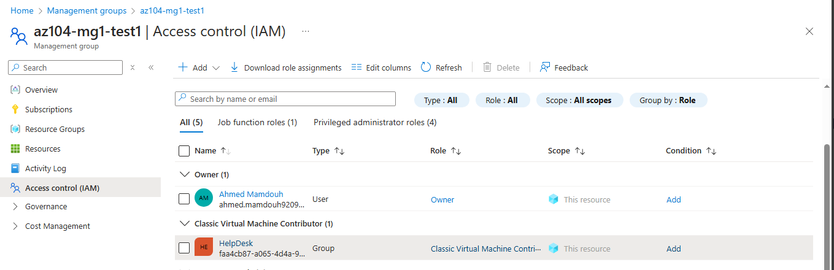
Notes:
The hd1 user will have full permissions to manage virtual machines and their configurations but will not be able to Assign access control permissions to other users.

Slide 12
Note :- Roles in Microsoft Azure come in two concepts
Microsoft Entra ID Role
Manage identity and access within Microsoft Entra Directory Examples (Global – user administrator) roles
Azure RBAC (Role-Based Access Control) Manage and control access to Azure resources (VMs, networks, etc.)Examples (Contributor, Reader, Virtual Machine Contributor)Roles

